Slide 1
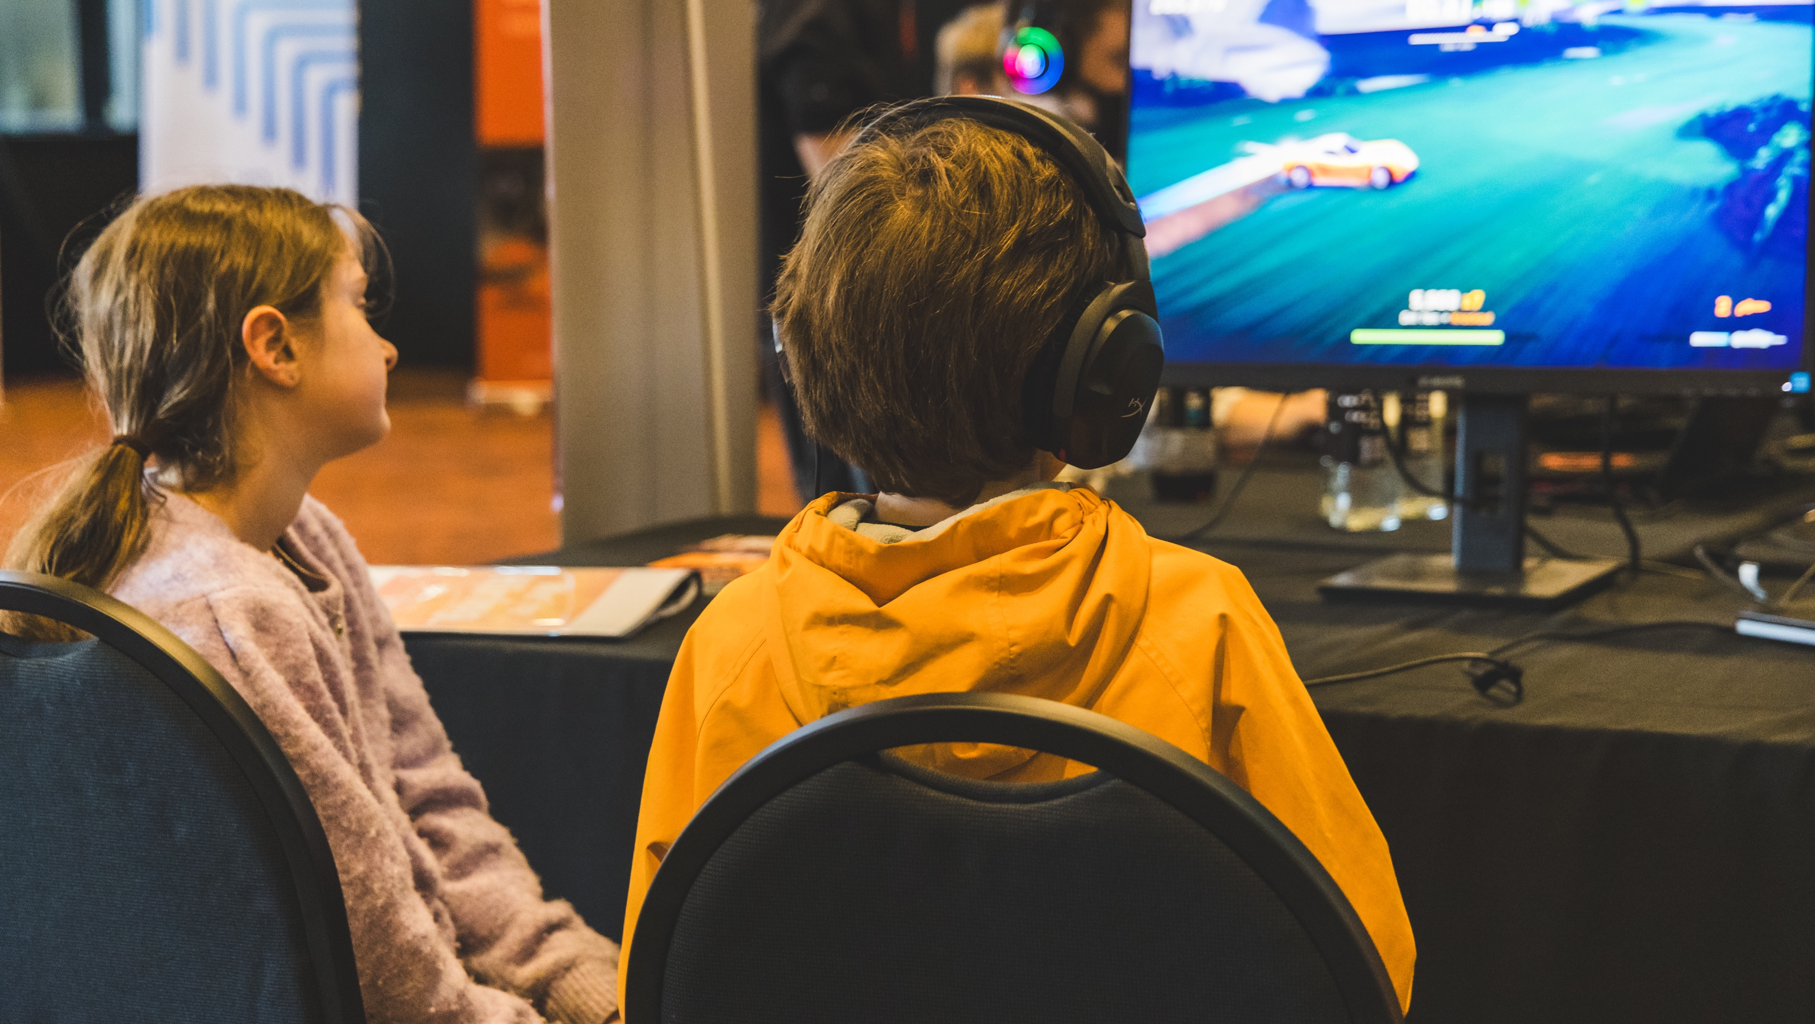
GDSR Webinar

Slide 2
Webinar Overview
GDSR – Latest updates
Clarifications to General Guidelines
Clarifications to Eligible Expenditure
Final Application process
Next steps
Pātai / Questions

Slide 3
GDSR Team
Amie Mills – Head of Funding​
Chantelle Cole – GDSR Programme Director​
Suzanne De Spong – Senior Communications Advisor​
Christina Arathimos – Corporate Services Coordinator​
Luke Campbell – Assistant Accountant​
Rebecca Tang – Business Affairs Advisor (Legal)​
Hui-Ping Wu– Associate Head of Corporate Services​

Slide 4
GDSR – Latest updates
Registration process for Year One, Oct 2023 - Jan 2024
36 studios successfully registered for final application
Estimated call on the GDSR in Year 1: $29.6M (including Pilot Phase @ $10.2M)
Letters of acknowledgement sent: 2 February 2024
Statement of Readiness process complete
Final Applications open: 1 April 2024
Final Applications deadline: 30 April

Slide 5
Clarifications to General Guidelines Multi-company operating structures
To be eligible to independently claim for the rebate, subsidiary studios must be constituted as separate legal entities. Generally, this means a separately registered limited liability company.
As a separate legal entity, eligible studios can claim against eligible expenditure incurred only by that particular entity.

Slide 6
Clarifications to General Guidelines General public release
Example A: A game made available for use only in a private club, or to participants enrolled in a course, or to members of a professional association would not be eligible.
Example B: A game made for surgeons, subject to it meeting the definition of a “game” under the GDSR, made available on a public-access platform (i.e. Steam), would be deemed to meet the criteria for general public release.

Slide 7
Clarifications to Eligible Expenditure

Slide 8
Well-structured market-level remuneration packages
Important clarification: The section pictured relates only to well-structured remuneration packages (employment).
i.e., these items are eligible if employees/staff performed the work.
For example: Marketing
Costs of employee hired in marketing space is eligible.
cost of marketing itself: e.g., costs of hiring billboard, is not eligible.

Slide 9
Clarifications to Eligible Expenditure Well-structured remuneration package
Footnote added: For the avoidance of doubt, a well-structured market-level remuneration package may comprise annual leave, KiwiSaver contributions, sick leave entitlements, incentives stipulated upfront in the employment agreement and aligned with the eligibility period, as well as training entitlements that are specifically set out, relate to game development, and are identifiable within eligible role remuneration packages.

Slide 10
Clarifications to Eligible Expenditure Website expenditure
Footnote added: Please be aware that website expenses will only qualify if an eligible game is directly hosted on the website. If the website serves primarily as a marketing platform and does not host the game, associated costs (unless related to remuneration) are not considered eligible expenditure.

Slide 11
Clarifications to Eligible Expenditure Calculation of eligible meeting attendance
Footnote added: This task list recognises that individuals may play multiple roles in a business. All expenditures on eligible tasks may be counted. If a staff member is wholly assigned to game development, then they do not need to calculate their attendance at general meetings versus game development meetings. However, for executives and other staff whose roles are not wholly assigned to game development, the time allocated to game development meetings can be averaged over a three-month period to determine the total allocation across the eligibility period.

Slide 12
Clarifications to Eligible Expenditure Game engine expenditure
Specific Inclusions:
expenditure on underlying game infrastructure such as game engines (excluding backend royalties tied to unit sales);

Slide 14
Final Application process
Go to our Portal - https://funding.nzonair.govt.nz/

Slide 17
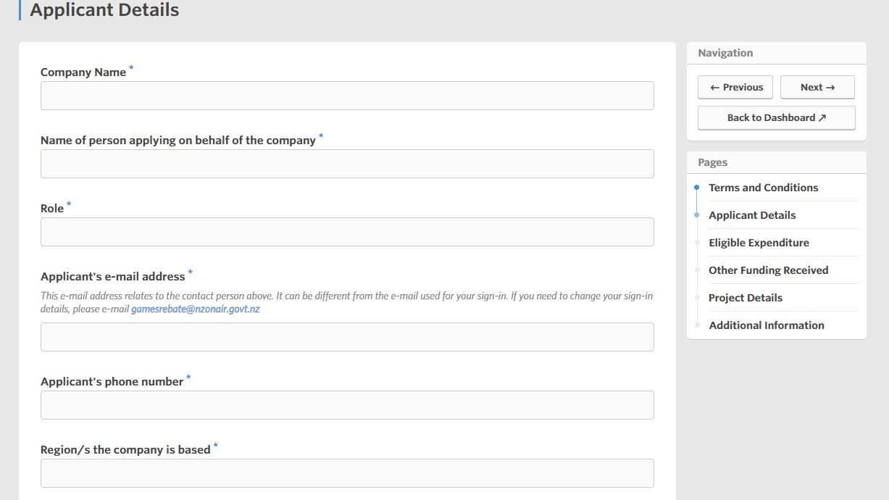

Slide 18
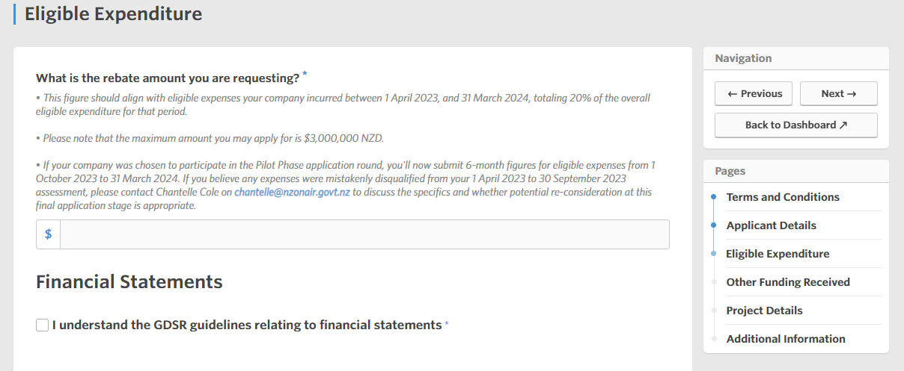
Notes:
Luke

Slide 20
Notes:
Luke

Slide 25
Next steps
Final applications: submissions open 1 April 2024
Final applications: submissions close 30 April 2024
NZ On Air assessment: April - June 2024
NZ On Air may follow up to confirm any rationales or information
Letters of Offer: Mid-June
Earliest we can accept invoices: 21 June 2024
Payments processed: June – July 2024

Slide 26
Pātai / Questions
Website: nzonair.govt.nz
Email: gamesrebate@nzonair.govt.nz
Newsletter: subscribe here

